Slide 1
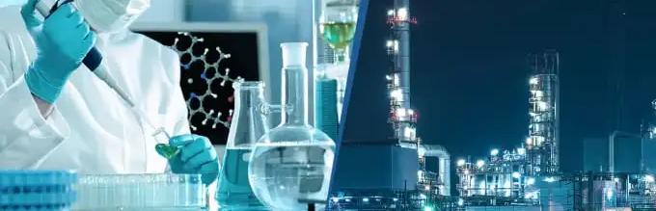
Industrial Chemistry
The Haber Process

Slide 2


Ammonia
Ammonia, NH₃, is a very important chemical raw material
It is used to produce other materials including:
Fertilisers – NH₄NO₃, (NH₄)₂SO₄, (NH₄)₂HPO₄ and urea (NH₂)₂CO
Polymers – such as nylon and acrylic plastics
Explosives – like trinitrotoluene (TNT), nitroglycerin and ammonium nitrate
Cleaning agents – ammonia solutions

Slide 3
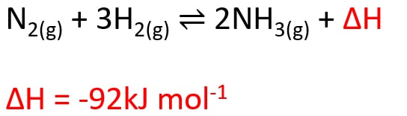
Haber process – ammonia synthesis
The Haber process involves a reversible reaction between hydrogen gas and nitrogen gas.

Slide 4
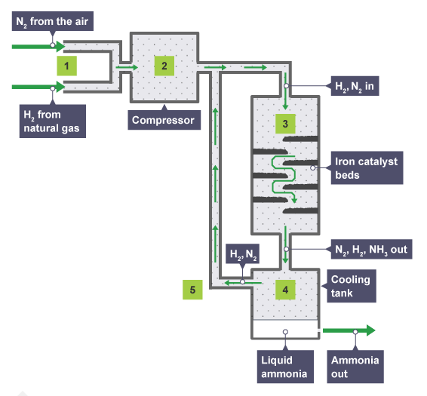
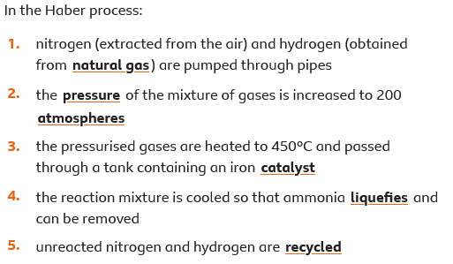
Haber process – ammonia synthesis

Slide 5
Optimising the process
At room temperature and pressure:
Reasonable equilibrium yield
Extremely slow rate to reach equilibrium
Higher temperatures increase the rate, however the reverse reaction is endothermic so high temperatures favour the equilibrium shifting to the left which reduces the equilibrium yield
High pressure increase both the rate and yield (can you explain why? How does pressure effect rate of reaction using collision theory? How does pressure effect equilibrium using LCP?)

Slide 6
Optimising the process
Collision theory – high pressure means more molecules in a certain area of space, this results in a higher frequency of collision, a great number of collisions in a time period gives a higher rate of reaction
LCP – if you increase the pressure, LCP predicts the equilibrium will shift to favour the side that partially counteracts this action (ie reduces the pressure again), so it will have the side of the reaction with the least number of particles. For the Haber process that is the right side, the products.

Slide 7
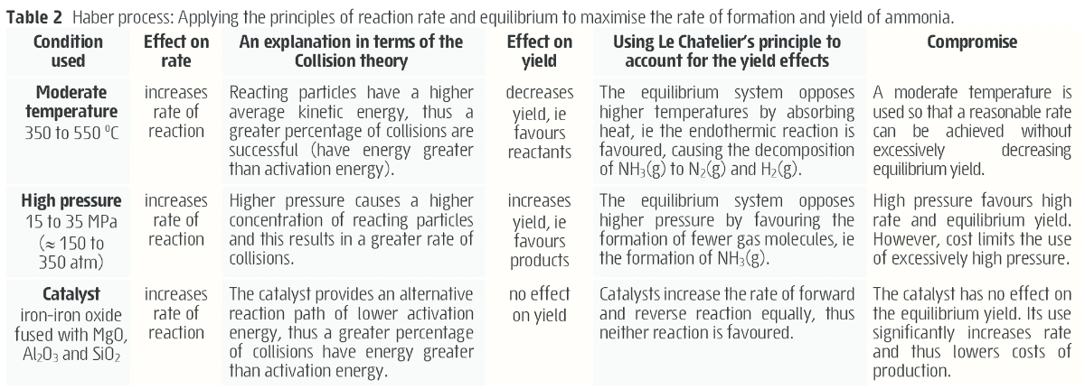
Optimising the process
BUT – high pressure is dangerous and expensive, making very high pressure uneconomical
Therefore, it is necessary to compromise on the conditions

Slide 8
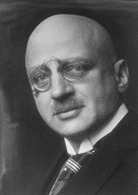
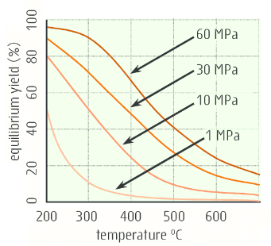
Overview
Fritz Haber (German chemist) found the optimal conditions for ammonia production
3:1 molar mixture of H₂(g) and N₂(g)
Temperature of 350-550 °C
Pressure of 15-35 Mpa
A catalyst – iron-iron oxide fused with MgO (silica and alumina can also be used – solid supports for the iron catalyst)
Gives reasonable rate, yields of 15-30 %

Slide 10
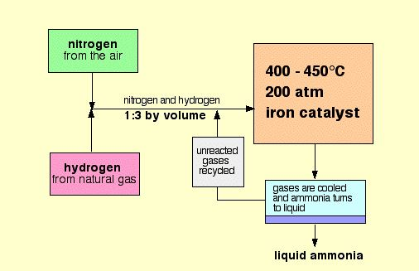
https://www.chemguide.co.uk/physical/equilibria/haber.html

